Slide 1

Cloud Computing in Logistics
GROUP 3

Slide 2
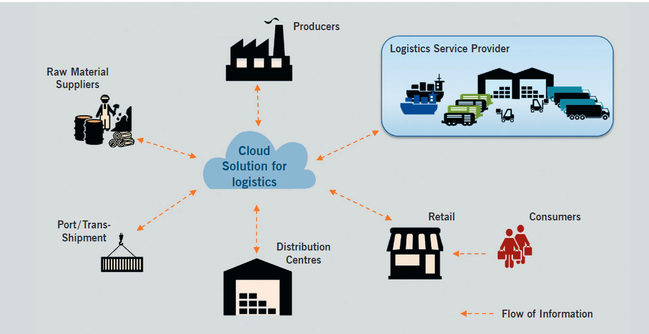
Cloud supporting collaboration & integration
The integration provide more recent and more accurate data and therefore increase supply chain visibility.
By using real time data and tracking systems more accurate forecasts become possible.
Figure 1: Possible Cloud System for Logistics Industries (Marisabel et.al., 2015)

Slide 3
Cloud in Logistics
Real-Time Pricing
Real-Time Inventory
Data Protection through Redundancy
Scalability
Providing a cost-efficient alternative

Slide 4
Real-Time Pricing
Pricing elements within transportation and warehousing can fluctuate based on any number of factors, such as weather, market conditions, or demand.
Through cloud computing, it allows for real-time pricing whereby quickly understand the price associated with every logistics element of the supply chain allows people to control their costs with finesse.

Slide 5
Real-Time Inventory
Real-time inventory management allows maximizing your ability to respond to demand fluctuations while holding onto your buffer against emergencies.
Data flow from the cloud gives people infinitely more precise control over their inventory levels.

Slide 6
Data protection through redundancy
Cloud computing has addressed that issue to prevent the loss of data which are outside the control of the supply chain.
Cloud solutions allow redundancies in data storage and processes, which serves as a backup.
Cloud is powered by multiple redundant servers that support your local servers in cases of outages or other sudden changes.

Slide 7
Scalability
Logistics faces difficulty in balancing data from multiple sites
Yet, cloud software helps in getting multi-site suppliers by tracking supplies and inventory across various locations
It also enables management to locate products at any stage of shipping regularly. This means it can help collect data about delays or bottlenecks that management can analyze to deal with disruptions.

Slide 8
Providing a cost-efficient alternative
Through cloud computing, supply chains won’t have to spend infrastructure and equipment to manage operations and collect, analyze, and share data. Since it’s hosted online, none of that is necessary for those said purposes, including expert labor.
It also reduces human error through its automated controls, which heavily contributes to operating expenses.
Saving that much can help any logistics operation, especially when manufacturing costs are rising.

Slide 9
Benefits associated with utilization of Cloud Computing in Logistic:
Effective utilization of logistic assets
Item visibility and ETA prediction
Maximum warehouse throughput
Maximum shipping speed
Automated route planning

Slide 10
Example of Cloud Computing in Giant E-Commerce Logistic: ALIBABA
Cainiao Network, Alibaba’s logistics affiliate (2013) with a group of shipping and delivery companies to create a logistics information platform that links a network of partners, warehouses and distribution centers.
Processing data for 70% of parcel deliveries in China, an average of 42 million a day (2016), while connecting more than 90 domestic and international partners.
How is this possible?
Alibaba Cloud.
The business relies heavily on cloud computing, helping to save an estimated 260 million hours a day in delivery time.

Slide 11
The logistics platform provides buyers and sellers with real-time information on their products.
Machine learning models and algorithms built into Alibaba's Cloud platform to provide a range of data-driven solutions.
Provide shipping companies and express carriers with everything they need to identify the best delivery route. These smart solutions have also helped Cainiao make accurate volume forecasts, and enabled address standardization and new e-shipping business models.
The company’s warehouse and domestic fulfilment centers use an AI-enabled smart supply chain to track supply and demand. As a result, packages can be monitored as they move around the world, including in the last mile of transit, using IoT-based communications.
These cloud solutions were put to the test during the latest Double 11 Global Shopping Festival (11.11.2020).
Result: packages reached consumers in Spain and France within 10 working days, 30 percent faster than normal delivery times.
Cloud computing has been one of Alibaba’s fastest-growing businesses in recent years. In the June quarter (2020), revenue from cloud computing grew 58.5% to 12.35 billion yuan ($1.75 billion).

